Slide 1

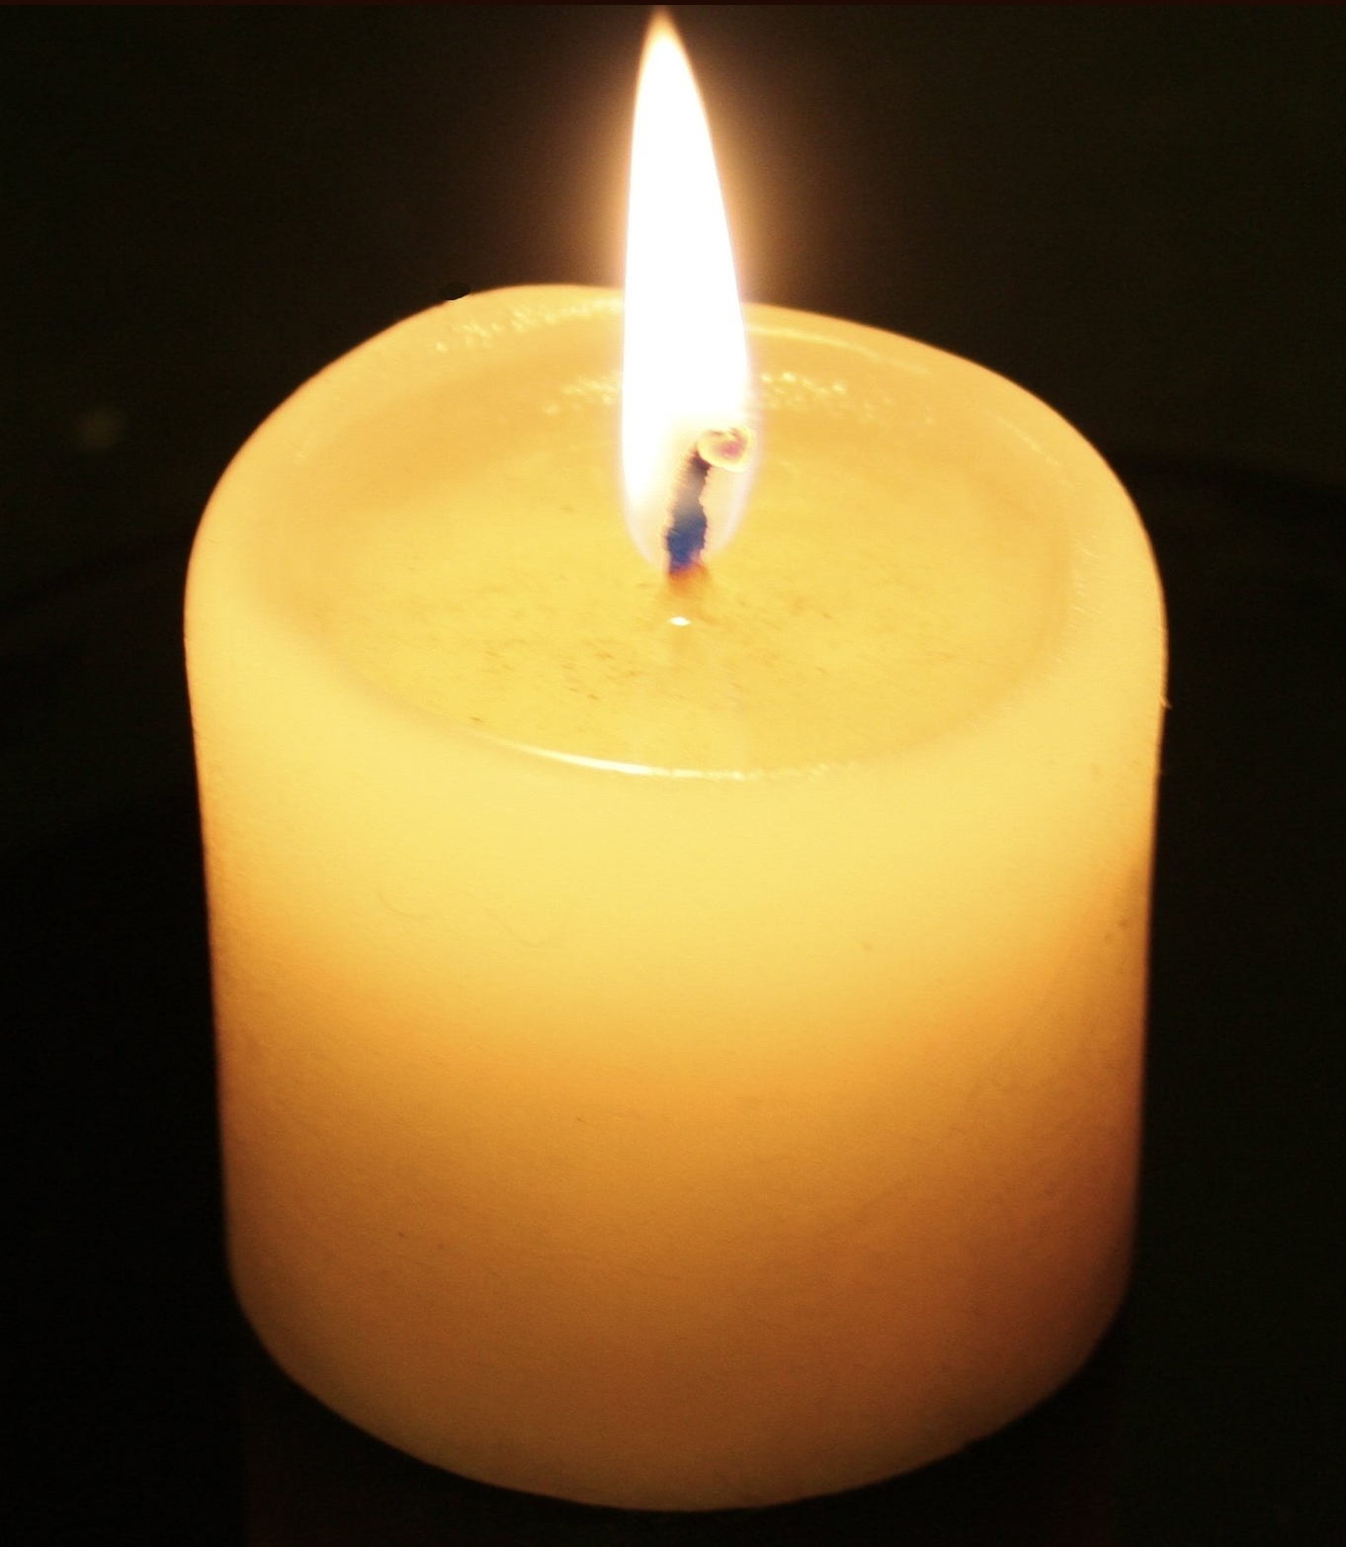
At St Margaret's Catholic Primary, Christ is firmly at the centre of all that we do.
This Photo by Unknown author is licensed under CC BY-SA.

Slide 2

We are learning to live like Jesus by being kind, resilient and respectful.

Slide 3
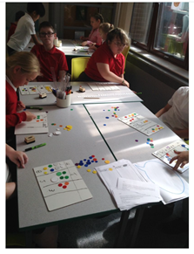
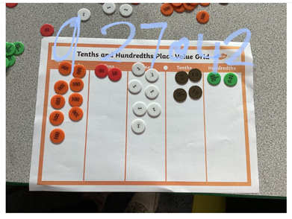
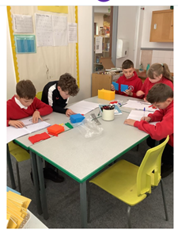
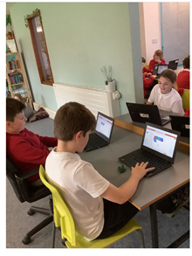
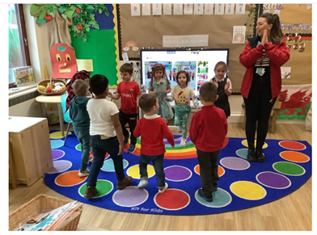
Developing the whole child academically, socially, morally, spiritually, physically, emotionally and culturally.

Slide 4
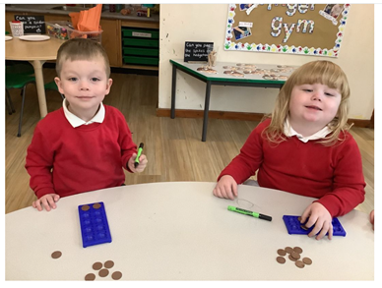
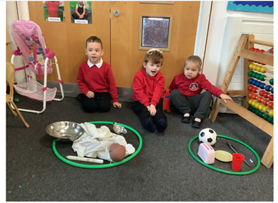
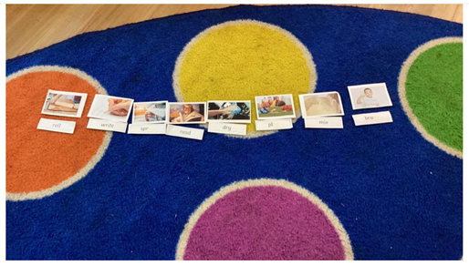
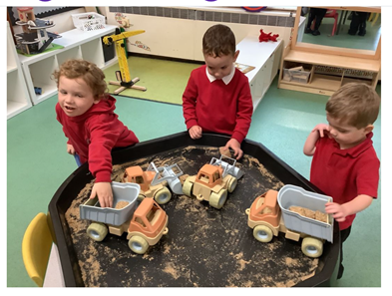
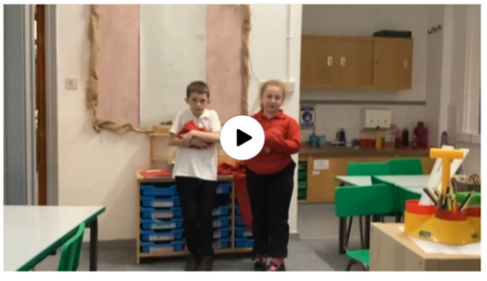
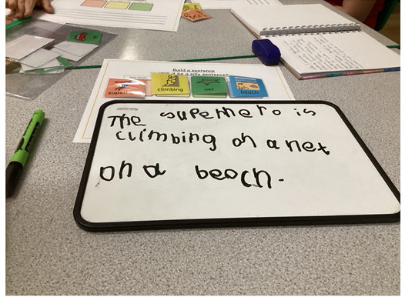
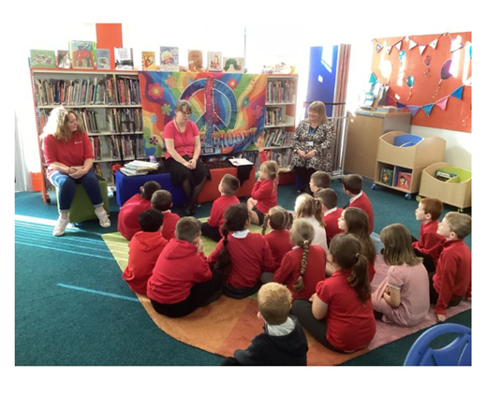

Slide 5
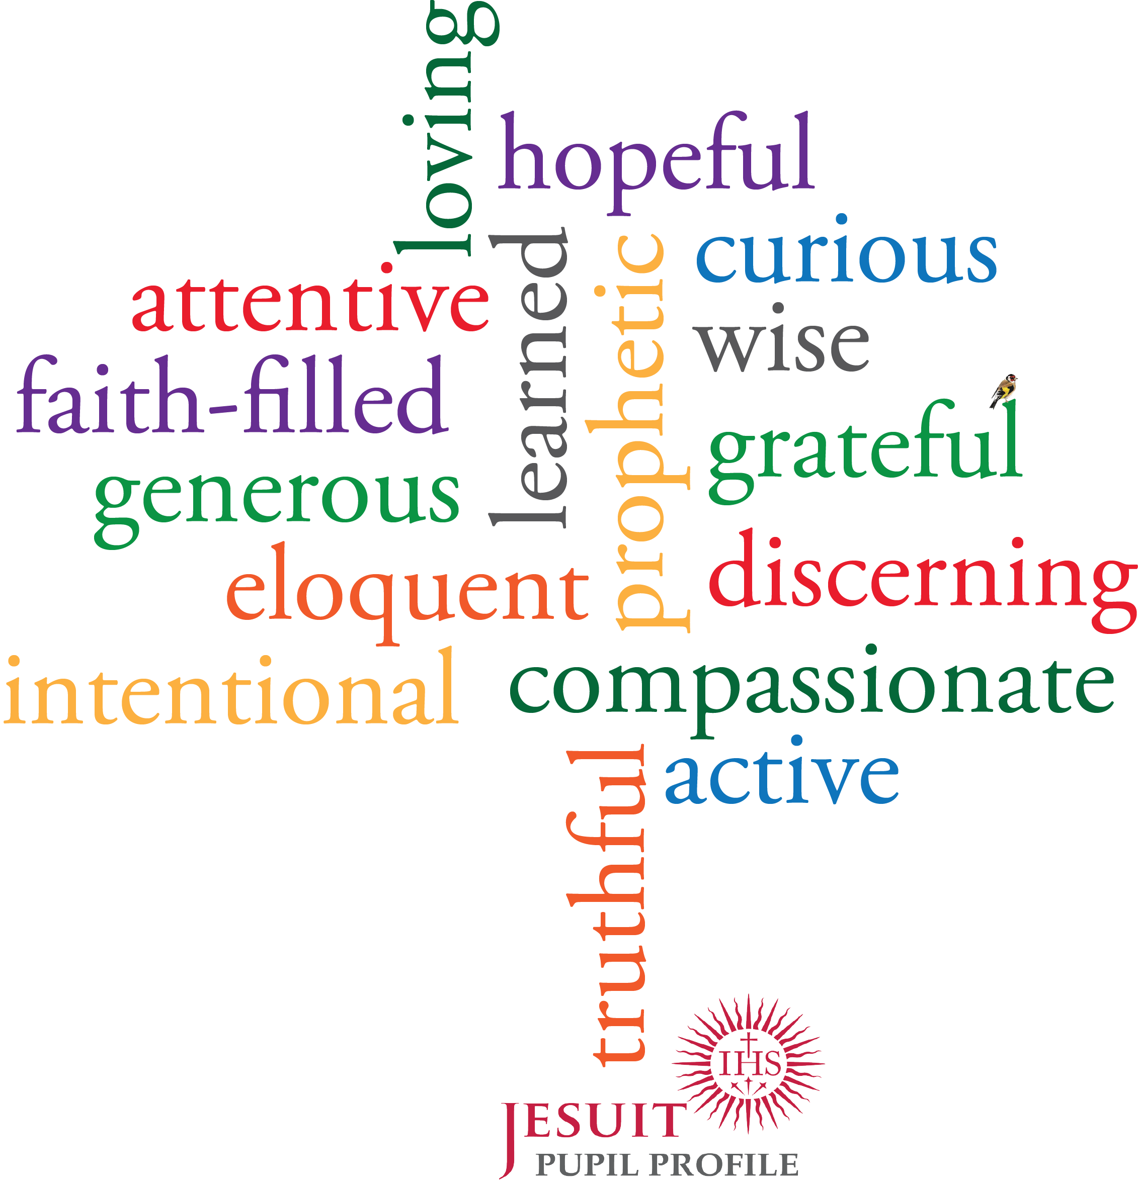
Developing virtuous individuals to discover their vocation for the benefit of all.

Slide 6

Build, maintain and repair relationships.
Story Telling
What's happened?
What were you thinking and how were you feeling?
Making Connections
3. Who else has been affected? And how?
Problem Solving
4. What are your needs and strength?
5. What do you want to happen now in order to move forward?

Slide 7
One family working together to develop a love of learning for everyone.

Slide 8
St Margaret's Catholic Primary is a community.

Slide 9
Vision Week
6th-10th November 2023
Monday | Tuesday | Wednesday | Thursday | Friday
Cricket Session for pupils in Years 3,4,5 and 6 Swimming for pupils in Years 3,4,5 and 6 Vision Presentation 3pm, 4.30pm,6pm Hall Mrs Hooper & Miss Conway The presentation will be repeated so you need only attend one session | Year 6 music session BCACS transition in school hall Coffee morning 9-10am Meet our Family Engagement Officer (Kayleigh Thomas) 10-11am Join a phonics session with Miss Williams 1.30-2pm R&R Room Join a reciprocal reading session with Mrs Williams 2-2.30pm R&R Room Fire Safety talk with pupils in Dosbarth Pinc & Dosbarth Aur | Dosbarth Aur and Dosbarth Glas attending mass at St Therease Church in Hirwaun 9.45am After school football club Meet the school ALNCO – Miss Rees 1.30-2.30pm Find out information about how we cater for pupils with additional learning needs. This is not to discuss individual pupils | Re-launch of the Big Bocs Bwyd Learn basic welsh with our Criw Cymraeg (Pupils) 1.30-2pm Hall Join a mental maths session with Miss Miles 2-2.30pm Hall Join a meditation session with Mrs Hooper 2.30-2.50pm Hall Well-being sessions explained 2.50-3.30pm Hall After school film club | Numeracy Cookery Class with parents Remembrance Day Assembly 2.30pm
A vision is unique to each individual school. It explains what the school is all about. We have been busy putting together the vision for St Margaret's and we would like to share this with you.
Here is a timetable of events/activities that are part of the vision, anything that is highlighted in yellow you are more than welcome to come and join us. You can pick and choose; you do not have to come to everything.

